Slide 1
Logistic regression
Venugopal Gopalakrishna-Remani (Venu), Ph.D., BVSc & A.H, MBA, PGDPM, ACUE

Slide 2
Your Success. Our Passion.

Slide 3
What is logistic regression?
Estimate (guess) the probability of an event given some previous data.
Works with binary data, event happens (1) or the event does not happen (0).

Slide 4
Outcome & independent Variables
Two possible outcomes, "0" and "1" ("dead" vs. "alive" or "win" vs. "loss")
Prediction is based on what?
Is the independent variable
Predict a student pass or fail in an exam based on the number of hours spent studying.
Number of hours studied become independent variable
We can also consider his/her IQ and that becomes another dependent variable and so on

Slide 5
When should you use logistic regression?
To predict the likelihood of an event to occur
To understand the relationship between the dependent variable and one or more independent variables by estimating probabilities using a logistic regression equation.

Slide 6
Logistic regression
With 14 points, 4 rebounds and 5 assists, will Dr.V will make it to the awesome team?
WE WILL SOLVE THIS AT THIS ONLINE WORKSHOP:
Pic Credit: https://www.shutterstock.com/image-photo/back-view-basketball-player-holding-against-

Slide 7
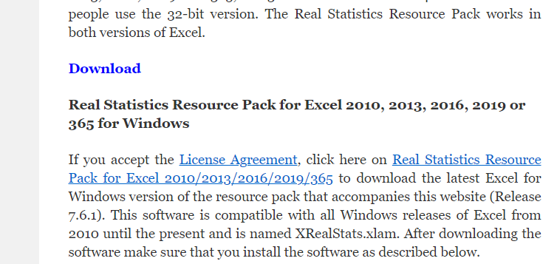
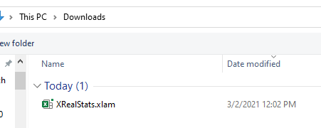
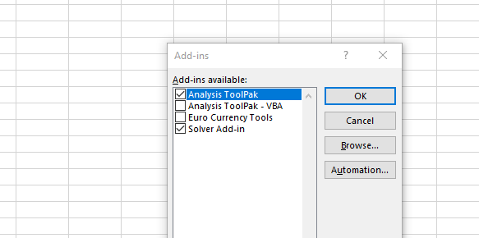
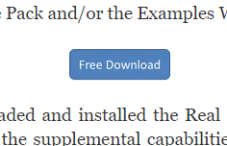
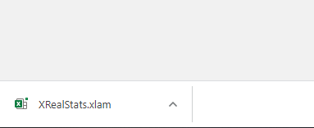
PROCESS 1: INSTALLING SOFTWARE
Go to Real Statistics .com (https://www.real-statistics.com/)
Click on Free Download
Download Real Statistics resource pack
Click on the download and install it
Go to Excel Home > Options > Add ins >Browse
Browse >downloads> XrealStats.Xlam
Once added in> addins

Slide 8
Data set

Slide 9
Sample Size
Sample Size:
Equation is 10k/q where k = the number of independent variables and q = the smaller of the percentage of cases with y = 0 or y = 1, with a minimum of 100.
For Example 1, k = 2 and q = 200/500 = .40, and so 10k/q = 50. A minimum sample of size 100 is recommended.

Slide 10
Process
Excel
> Add-ins
>Real Statistics> Data Analytic tools
>Reg>Logit and Probit regression
>Select Input Range to Fill
> Select Output Range –New
>OK

Slide 12
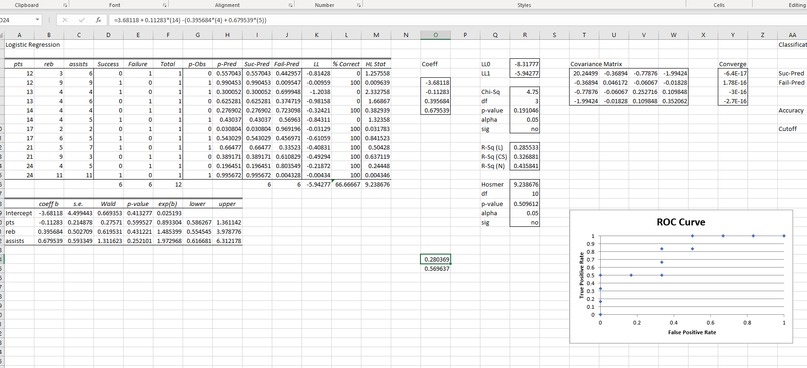

Slide 13
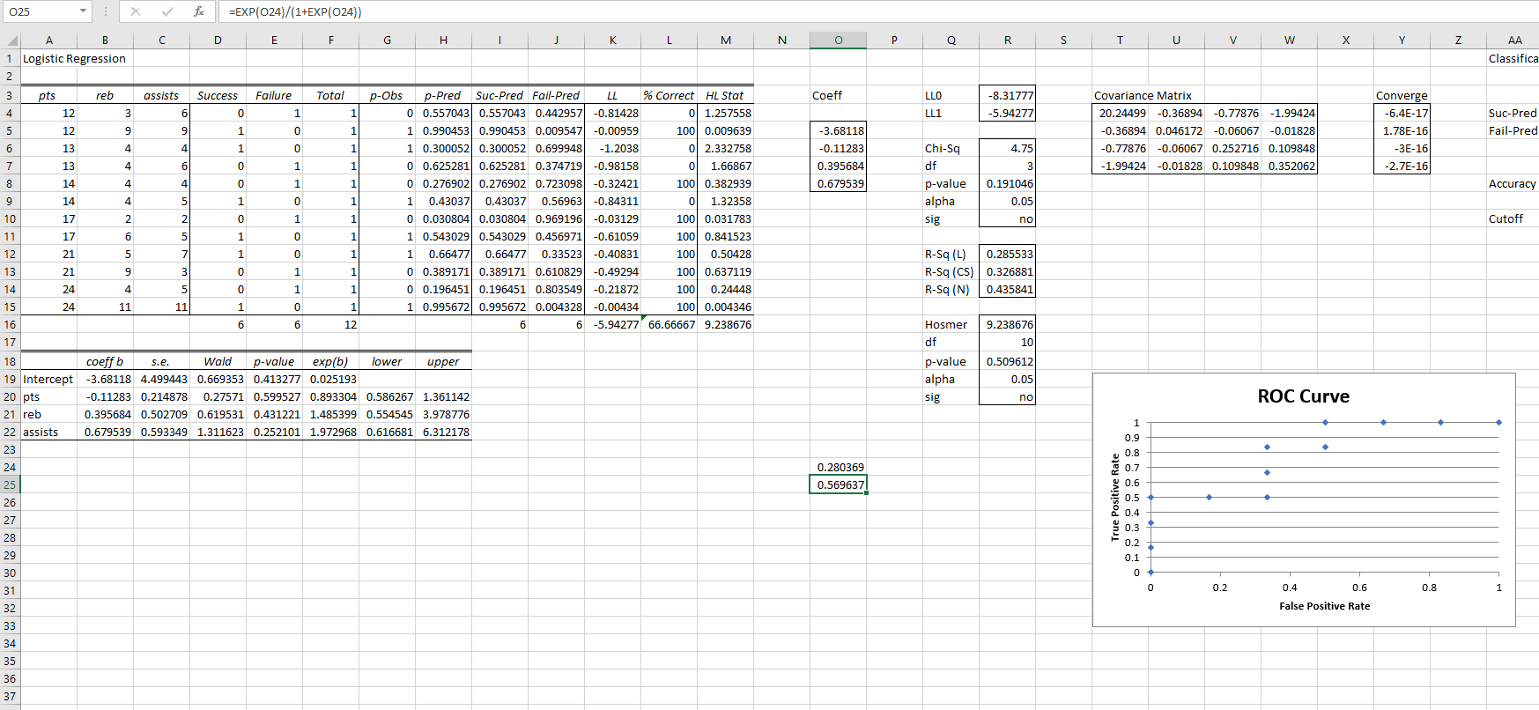

Slide 14
References
You can download the realstats from https://www.real-statistics.com/free-download/real-statistics-resource-pack/
Basketball data from https://www.statology.org/logistic-regression-excel/

Slide 15
Photo credits
Pic Credit: https://www.shutterstock.com/image-photo/back-view-basketball-player-holding-against-

