Slide 1
Accounting & Financial Reporting

Slide 2
Accounting and Financial Reporting Staff
Brenda Golemon, Financial Accountant
bgolemon@uttyler.edu
Esteici Licea, Financial Accountant
elicea@uttyler.edu
Danielle McDonald, Accounting & Financial Reporting Manager
daniellemcdonald@uttyler.edu

Slide 3
Accounting and Financial Reporting Staff
Brenda Golemon, Financial Accountant
bgolemon@uttyler.edu
Areas of expertise:
Capital Projects
SAHARA Reconciliation Monitoring
Ad Hoc Reports

Slide 4
Accounting and Financial Reporting Staff
Esteici Licea, Financial Accountant
elicea@uttyler.edu
Areas of Expertise:
Requests for adds/changes to Departments, Cost Center, BA’s
USAS (Uniform Statewide Accounting System) – processing/reconciling expense reimbursement of appropriations
IDT’s- Interdepartmental revenue/expense transfers

Slide 5
What is Accounting & Financial Reporting responsible for?
Reviewing/Processing Monthly Journals
Annual Financial Report (AFR)
Monthly Financial Report (MFR)
Monitor SAHARA Account Reconciliations
Internal and External Financial Reports
Quarterly Expenditure Reports
USAS to ABEST recon
Sources & Uses Report
IFRS (Integrated Fiscal Reporting System)

Slide 6
What services do we provide?
List of cost centers and projects under a budget authority
Process requests for new/updates to cost centers, departments, and budget authorities – submitted via Docusign
Process journals - submitted via email to: Journal_Request@uttyler.edu

Slide 7
What services do we provide?
Assistance with Account Reconciliation questions, including training
Capital Projects
Ad Hoc Reporting

Slide 8
Account Reconciliation Training

Slide 9
Purpose of Reconciliations
Preparation of the reconciliation and the related approval process provide documented evidence of our good stewardship and accountability of UT Tyler financial resources for which we are responsible. Timely completion and approval of monthly reconciliations facilitates assurance of:
Accurate and valid ledger entries and balances
Absence of unauthorized transactions
Timely and accurate exception resolution

Slide 10
Purpose of Reconciliations
Reconciliation, review, and approval of cost center and project financial records should be performed on a monthly basis by knowledgeable personnel. The reconciliation, review and approval should occur within 30 days of the official month-end close.

Slide 11
Purpose of Reconciliations
Confirm all transactions booked are appropriate for your cost center/project. IF you find something that does not belong to you, or is inaccurate, you are able to add comments and/or flag the object. Even with this exception found, the reconciliation should still be completed, and the BA should still approve because the comment indicates the error.
The “approval” does NOT indicate everything is correct, it confirms it has been reviewed and errors have been identified.

Slide 12
Monthly Process
Accounting & Financial Reporting office sends an email when the month is closed.
This email contains the calendar of due dates and an email with a link to the instructions for SAHARA reconciliations.
Complete the monthly reconciliation in SAHARA by department. This will ensure all cost centers and projects associated with the department are included.

Slide 13
Reconciling
Verify all employees belong in the department.
Verify the amounts look reasonable and there are no amounts that look abnormal or items that were not expected.

Slide 14
Reconciling
Review source documentation for all transactions (receipts, invoices, etc.)
Verify all expenses were authorized for payment against the cost center, department, grant or capital project.

Slide 15
Reconciling
Verify transactions with the Budget Transfer Documentation.
Verify expected revenue by source and reasonableness of amount. (example DOC ID beginning with SSF are Student Service Financial journal)

Slide 16
Documentation Maintained
Expenses
Department initiated expenses:
Detailed Invoice/Receipt
Procurement Card
Procurement Statement
Detailed Receipts

Slide 17
Documentation Maintained
Travel Card
Travel Card Statement
Detailed Receipts
Bookstore
Receipts/email

Slide 18
Documentation Maintained
Postage
Interdepartmental Postage Charge
Copy Center
Request Form/receipt
Telephone Charge
Email with breakdown of charges

Slide 19
Documentation Maintained
Transfers
Transfer Request
General Ledger Entry
Documentation (journal entry attachment / email)

Slide 20
Documentation Maintained
Income
Cash / Check received
Copy of check
Copy of Deposit Receipt from Cashier
Credit Card Machines
Settlement Reports

Slide 21
Documentation Maintained
Direct Receipts from Students thru SBS
Reasonableness
# of students at $ per lab, ticket, etc.
Can request detail if needed

Slide 22
Questions to ask yourself for corrections
Why are we doing this correction?
Should this be corrected via Voucher/Deposit Correction
A voucher can only be corrected one time. After that it would have to be fixed by a journal.
Where do these numbers come from?
Who is approving this?

Slide 23
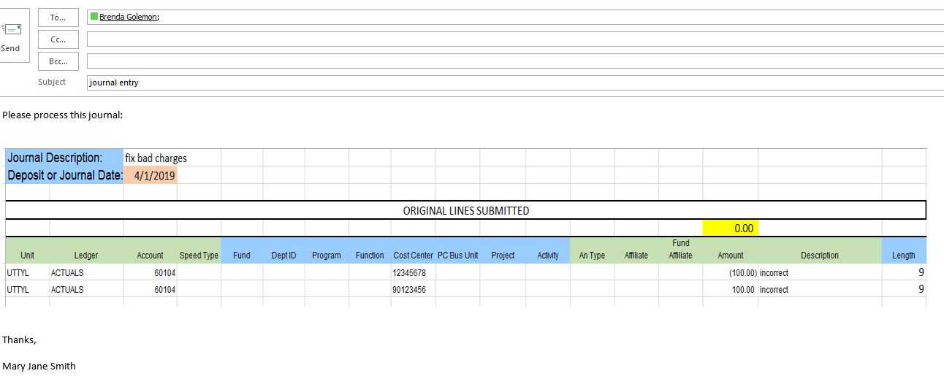
Journal Corrections
When submitting journals to journal_request@uttyler.edu, all journals must have proper approvals and supporting documentation.
Example of insufficent request:

Slide 24
Items to Remember
Submitted to individual, not journal_request@uttyler.edu
Insufficient journal description
Insufficient line description
No explanation as to why it’s being done
No approval (BA)
No Supporting documentation

Slide 25
Reconciliation Completion
Upon reconciliation completion SAHARA will generate a “no reply” email to the BA for approval. The header of the email is shown below.
This does not go through the workflow notification process so BA’s will NOT receive an alert on their homepage.
They can either click the embedded link in the email or go through SAHARA itself to approve the reconciliation.

Slide 26
Purpose of Reconciliations
As a reminder, failure to timely complete and approve account reconciliations for both projects and cost centers could allow incorrect or fraudulent transactions to be undetected. The integrity of the financial information used for management decision making and assurance of fiscal stewardship depend on the successful execution of the monthly reconciliation process.

Slide 27
Reconciliation Monitoring
Per Audit requirements, Accounting & Financial Reporting monitors that completion of the reconciliations to verify they are being done on a timely basis.
After the due date, a status report is run from SAHARA, which shows all areas that are not fully completed.
Based on this status report, those departments will receive an email reminding them to please have that area fully completed within 5 business days.
A second reminder will be sent after this time frame if the department is still showing incomplete on the status report.

Slide 28
Helpful Queries
UTT_GL_DEPT_CC_LIST
List of all departments with Cost Centers and Projects by Budget Authority for UTTYL
UTT_GL_TRANSACTIONS
List of all transactions in a Department or Cost Center
UTT_PO_PROCARD_DPT_TRANS_DTL
UT Tyler Procard Departmental Transaction Detail
UTZ_GL_ACCTLIST
Active Accounts with Descriptions

Slide 29
Definitions

Slide 30
Fund vs Function
What is a Fund code?
The Fund Code determines the type of monies being accounted for
What is a Function code?
The Function code tells the purpose the monies are being used for

Slide 31
Fund Codes
21xx – Educational and General Funds (E&G)
31xx – Designated Funds
3100’s are self-funded
3105’s are Designated Tuition
32xx – Service Center Funds
4xxx – Auxiliary Funds
5xxx – Restricted Funds

Slide 32
Fund Codes
5100 – Federal Contracts & Grants
5200 – State Contracts & Grants
5400 – Local Contracts & Grants
5500 – Gifts (we get full amt)
5600 – Endowments (we get interest off of investment)
5700 – Direct Loans
5800 – Private Loans
All 5xxx are restricted funds

Slide 33
Function (NACUBO) Codes National Assoc. of College University Business Officers
100 – Instruction
200 – Research
300 – Public Research
400 – Academic Support
500 – Auxiliary
600 – Student Services
700 – Institutional Support
800 – Operations & Maintenance
997 – Scholarship

Slide 34
Account Categories
1xxxx – Asset Accounts
2xxxx – Liability Accounts
3xxxx – Fund Balance Accounts
4xxxx – Revenue Accounts
5xxxx – 8xxxx – Expense Accounts

Slide 35
Expense Account Categories
5xxxx – Salaries & Wages
6xxxx – Various Categories (ex. Professional Fees, Dues, Travel, etc.)
7xxxx - Transfers
8xxxx - Depreciation & Capital Purchases

Slide 36
Departmental Forms

Slide 37
Things to Consider
When requesting a new cost center, if the funding is coming from an existing cost center the funds must be the same.
Example – if the new cost center is a 3100 fund it must be funded from a 3100 fund.
If a new cost center requires a new department, request the new department first. Once you have the new department number, then request the cost center.
Any department/cost center change which impacts a position, will require an e-form.

Slide 38
Add/Change Department & BA

Slide 39
Add/Change Department & BA

Slide 40
Things to Consider
When adding a new BA, the BA will get a confirmation email that they have been added
In this email they are notified of a required training that must be completed within 10 days of the notification.
The training acknowledgement is completed through DocuSign

Slide 41
Add/Change a Cost Center

Slide 42
Request to Add/Change a Cost Center

Slide 43
Request to Add/Change a Cost Center

Slide 44
Final Items
All requests for Financial Reporting need to come through our office to verify accuracy, consistency, and reliability to our AFR
This presentation, along with FAQ’s are available on our website.
https://www.uttyler.edu/accounting-and-financial-reporting

Slide 45
Q & A

