Slide 1
Entering “Amount Only” Lines on a Requisition
Procedures for entering Amount Only lines on a Requisition which results in a blanket purchase order.

Slide 2
Amount Only
“Amount Only” refers to a line setting on a purchase order that allows a balance to be carried and be vouchered against multiple times. These one-line purchase orders are commonly referred to as Blanket POs, but it’s also possible for a purchase order to have multiple amount only lines.
Please note the following:
When creating a requisition, follow the navigation directions and initial steps found on the “Create Requisition” procedures Job Aid. Amount Only is set on the Checkout – Review and Submit page (see following slides for instructions).
Amount Only lines can only be for services (not goods) and have the quantity of 1.
If a purchase order has already been dispatched that you want to change to Amount Only, please fill out a Purchase Order Change Request (POCR) form found in DocuSign Templates. This is not possible if the line has an already paid voucher attached to it.

Slide 3
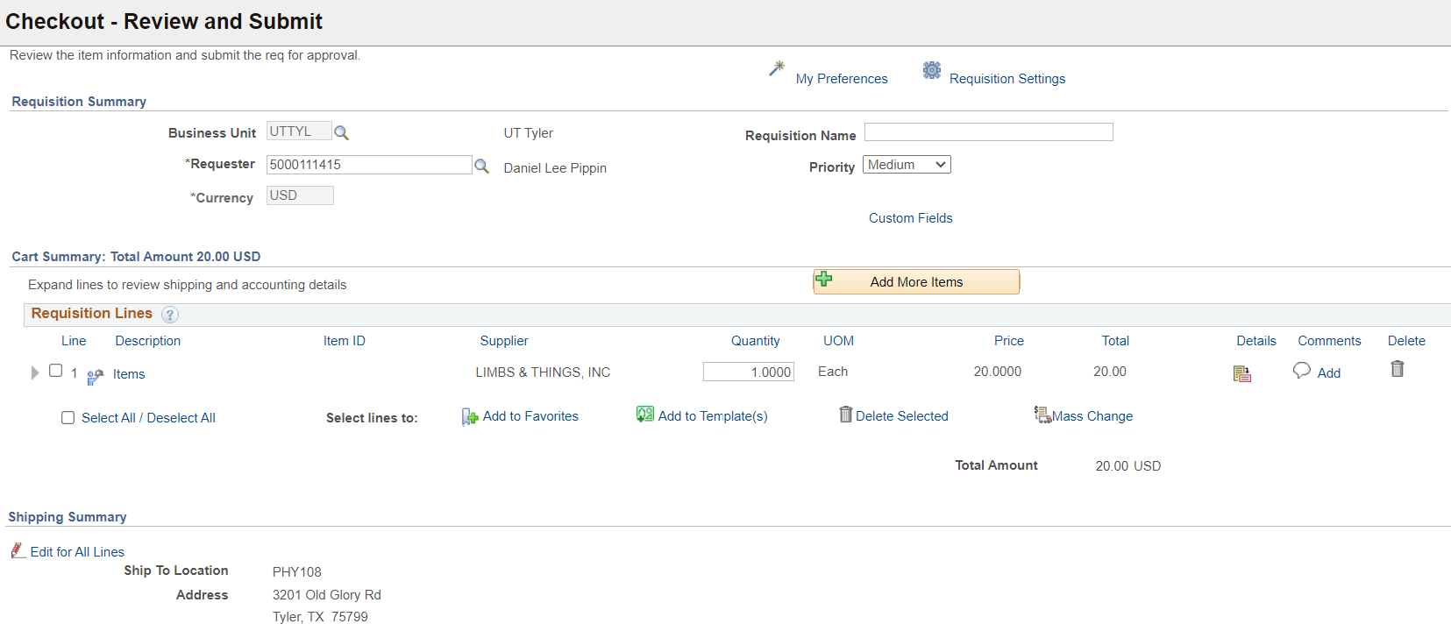
Create Requisition: Checkout – Review and Submit
To make Amount Only
Ensure Quantity is 1
Click the Line Details icon

Slide 4
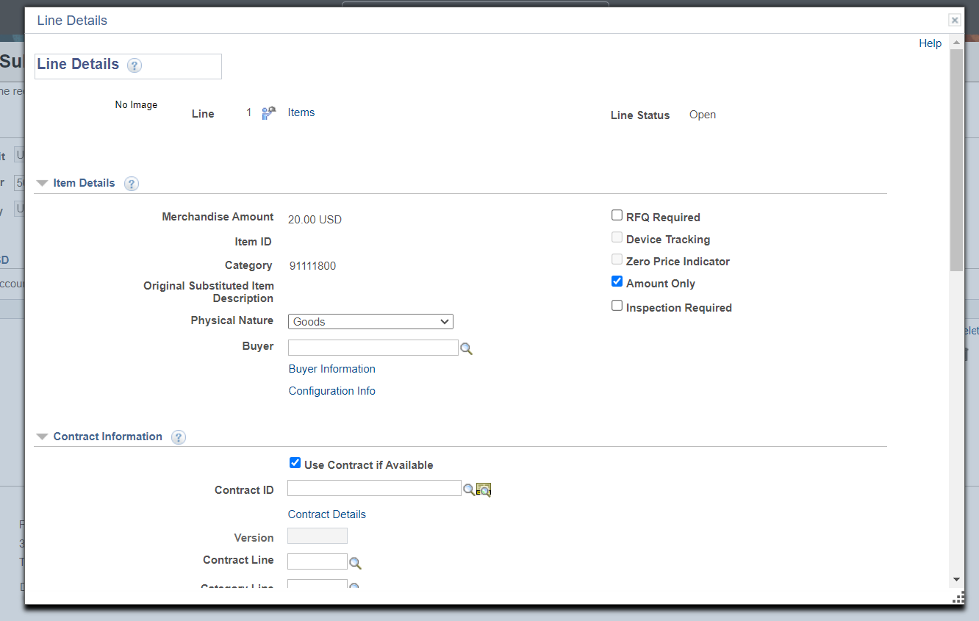
Create Requisition: Line Details
Check the Amount Only box
Scroll down and Click OK
A message box will pop-up warning that the line will be repriced if quantity is not 1. Click Yes.

Slide 5
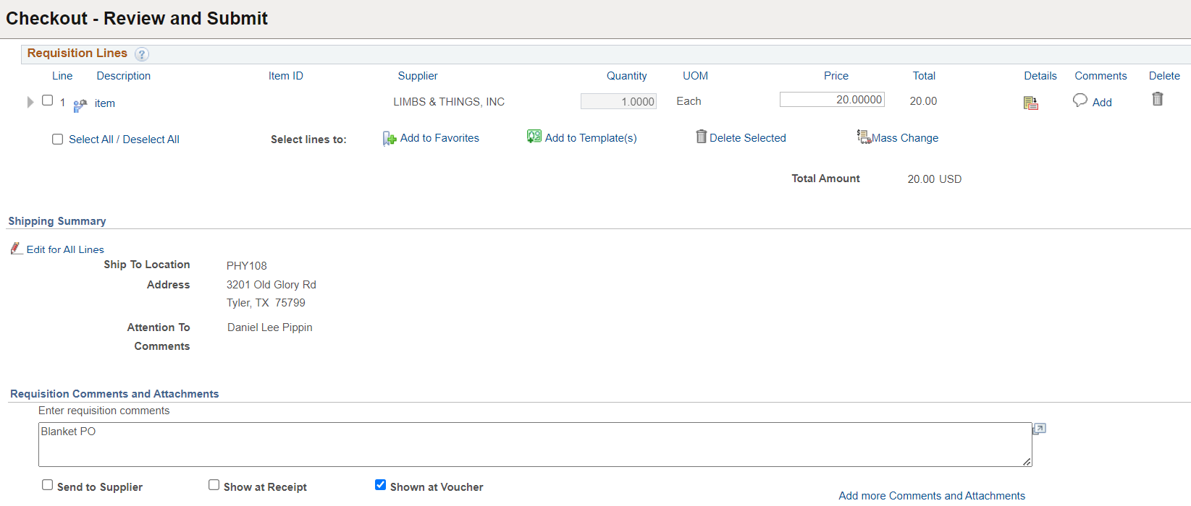
Create Requisition: Comments
When the screen returns to Checkout – Review and Submit, add comment for Blanket PO and check the “Shown at Voucher” box.
Proceed with Requisition per Create Requisition procedures

Slide 6
Procurement Services purchasing@uttyler.edu

